Slide 1
Balancing Durability and Deployability:
Enhanced Situational Awareness (ESA) for Non-Combat Tactical Vehicles
Robert A. Pilgrim, PhD & Roy C. Brown, III
Bevilacqua Research Corporation, Huntsville, AL

Slide 2
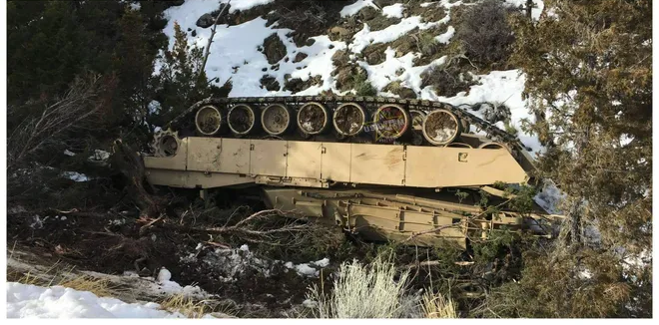
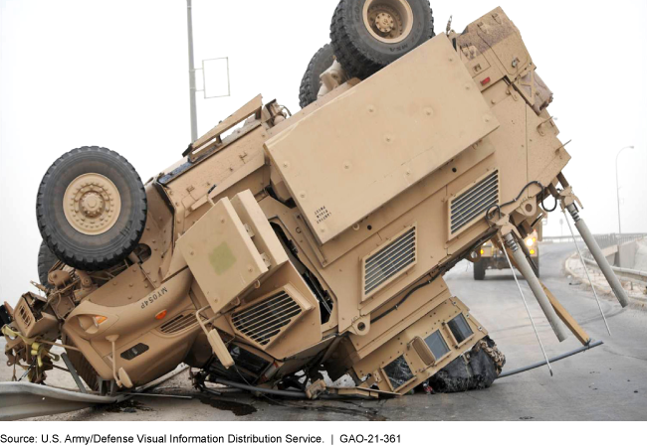
The Problem: Legacy Fleet Training Vulnerability
The Shocking Safety Baseline:
  The Army and Marine Corps reported 3,753 non-combat accidents involving tactical vehicles (tanks and trucks) over a 10-year period (2010–2019).
The Rollover Hazard: Rollovers represent only 25% of accidents but 63% of fatalities. Large armored systems (M1, Bradley, Stryker, MRAP) are exceptionally vulnerable due to high centers of gravity.
Cognitive Blind spots:
  Up to 70% of accidents correspond to low situational awareness.
  Crucially, 83% to 86% of fatal training accidents occur during daylight hours on regular paths, driven primarily by cognitive overload rather than basic physical sightline limitations.

Slide 3
Standardizing "Extreme Industrial" Ruggedization
The Ruggedization Bottleneck: Standard Commercial Off-the-Shelf (COTS) devices fail in tactical vehicle vibrations, but full MIL-STD testing multiplies engineering cycles and project costs exponentially.
Introducing SPECOM-STD: Rather than battlefield-ruggedizing, we derive standards from specialized commercial sectors facing extreme parameters:
  Heavy Open-Pit Mining & Bulk Steel Production: Searing heat, fine particulates, corrosive runoff.
  NASCAR Professional Racing: Sustained extreme temperatures, fierce vibration, oil line exposure.
Risk-Adjusted Reliability: Accepting a minor decrease in Mean Time Between Failures (MTBF) yields a 10x reduction in implementation costs, making fleet-wide deployment of ESA financially viable.

Slide 4
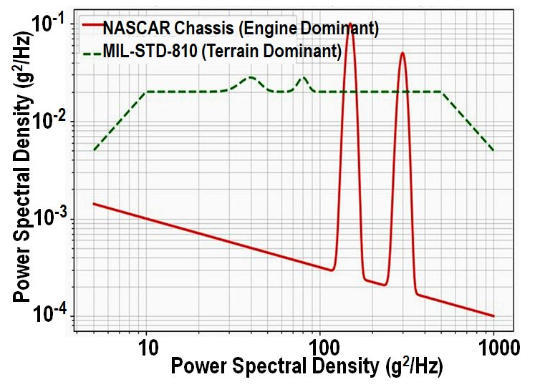
Mechanical Durability Analysis
Alternative Vibration Envelopes (Figure 1):
  NASCAR Chassis: High-frequency, engine-dominant
  vibration profiles that parallel engine fatigue lines.
  MIL-STD-810 Terrain-Dominant: Lower-frequency,
  high-displacement energy profiles.
Shock Test Nuance:
  Combat-rated MIL-STD-810H Method 516.8 tests
  for ballistic shock and near-miss artillery blasts
  (300g to 1,000,000g over < 180 ms using sawtooth waves).
  Training-rated hardware only needs to survive mechanical shocks (Method 516 drop testing: 26g to 75g over half-sine wave profiles), which matches standard manufacturing testing parameters.
Cost-Efficient Damping Modifications:
  Replace standard rubber isolators with military-grade wire rope isolators.
  Utilize non-obstructive particle damping (brackets filled with tungsten micro-spheres).

Slide 5
Environmental Standards Comparison
Environmental Feature | NASCAR On-Board Specs | Special Industrial Specs | Military (MIL-STD-810H / 461G)
Testing Standard | SAE J1455 | IEC 60068-2 / MIL-STD-810 | MIL-STD-810H / MIL-STD-461G
Ambient Temp | Up to 140°F (60°C) in cockpit | -40°F to 158°F (-40°C to 70°C) | -60°F to 160°F (-51°C to 71°C)
Max CPU Temp | Throttles at 185°F - 203°F | Sustains 212°F (100°C) (Xeon/Atom) | Sustains 221°F+ (105°C+)
Shock Tolerance | Crash survivability (~50G/11ms) | 20G (Std) to 50G (Custom) | 40G to 75G (Method 516)
Vibration | High-frequency mechanical | 2G to 5G (IEC 60068-2-6) | 4.7 Grms+ (Method 514)
EM Tolerance | CISPR 25 / ISO 11452 | CISPR 35 / FCC Class A/B | MIL-STD-461G

Slide 6
Crucial Safety Constraints: IP & Latency
Ingress Protection (IP) Requirements:
  Tactical Environment: Demands resilience against fine talcum-like sand, thick mud, and high-pressure washdowns.
  The SPECOM Match: Industrial equipment standardized to IP67/IP69K easily resists localized mud, dust, and continuous high-temperature pressure washing.
The Hard 40ms Latency Barrier:
  The Human Limit: Visible latency above 80ms visibly degrades a driver's steering and braking performance.
  The Vestibular Sync Limit: Physical movement combined with screen latencies above 40ms triggers severe motion sickness, disorientation, and postural instability in drivers.
  Engineering Directive: The entire glass-to-glass rendering path (camera capture to display output) must operate below 40ms to support closed-hatch operation.
Camera Capture
Stream/Blending
Screen Output
Total Latency
16ms
10ms
10ms
36ms

Slide 7
Low-Cost Tier 1 & 2 Configurations
Level 1: Driver View Day Only (≤≤ 25ms Latency)
    Architecture: Focuses on low latency and low cost over complexity.
    Sensors: High-framerate analog visible camera (e.g., Opticom CC02-V, 60 fps; 16ms scan rate).
    Signal Path: Feeds an analog distribution amplifier (Extron MDA 2V EQ) straight to a rugged analog monitor.
    Total Latency: < 25ms (Well within the safe zone).
    Cost: Under $1,000 per system.
Level 2: Driver View Day/Night (≈≈ 50ms Latency)
  Upgrade: Integrates a thermal/LWIR camera (Teledyne PathFindIR II) alongside the visible camera.
  Signal Path: Analog cameras feed into a hardware-blending On-Screen Display (OSD) controller (Advanced Micro Peripherals VAC2000).
  Total Latency: ~50ms (due to the 30ms latency of the thermal core).
  Cost: ≈≈ $4,000 per system.

Slide 8
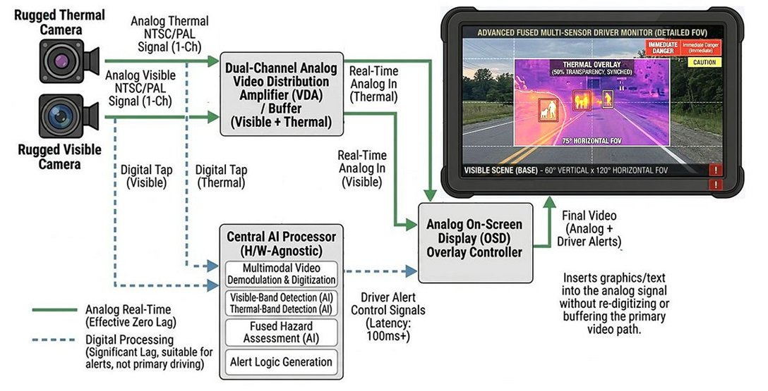
Tier 3: Dual-Path Frame-Grabbing and Warning Overlay

Slide 9
Edge AI Deployment Tiers
Deployable Edge Processing Tiers
Application Tier | Target Processing Power | Common Hardware Matches | Target Operational Scope
Basic Threat Detection | 10 - 30 TOPS | Hailo-8, Jetson Nano | High-contrast bounding boxes, basic target tagging on single camera feeds.
Autonomous Driving | 40 - 100 TOPS | Jetson Orin NX, Rockchip RK3588 | Real-time pathing overlays, obstacle identification, multi-camera tracking.
Multi-Sensor Fusion | 200+ TOPS | Jetson AGX Orin, Hailo-8 Century | 360-degree high-definition video stitching, complex deep sensor fusion.
Modular Open Systems Approach (MOSA) Compliance:
  System is run entirely on a standard, containerized Linux OS stack.
  Guarantees that hardware nodes are interchangeable, meaning processors can be upgraded quickly
  as chip tech advances.

Slide 10
Strategic Policy Recommendations
Establish a SPECOM-STD Procurement Category:
  Define a clear "Special Commercial" equipment track for non-combat, logistics, and training platforms to bypass long MIL-STD-810 design cycles.
Field Cost-Effective Safety Systems Now:
  Deploying affordable, modular safety upgrades across the legacy fleet today is a practical, life-saving step that is far better than leaving vehicles unmonitored while waiting decades for a fully funded military-grade combat solution.
Modernize through Active Range Testing:
  Use low-cost training-fleet installations as real-world testbeds to capture soldier usage logs and imagery data, directly informing and accelerating future MIL-STD combat systems development.

Slide 11
Discussion

